Slide 1
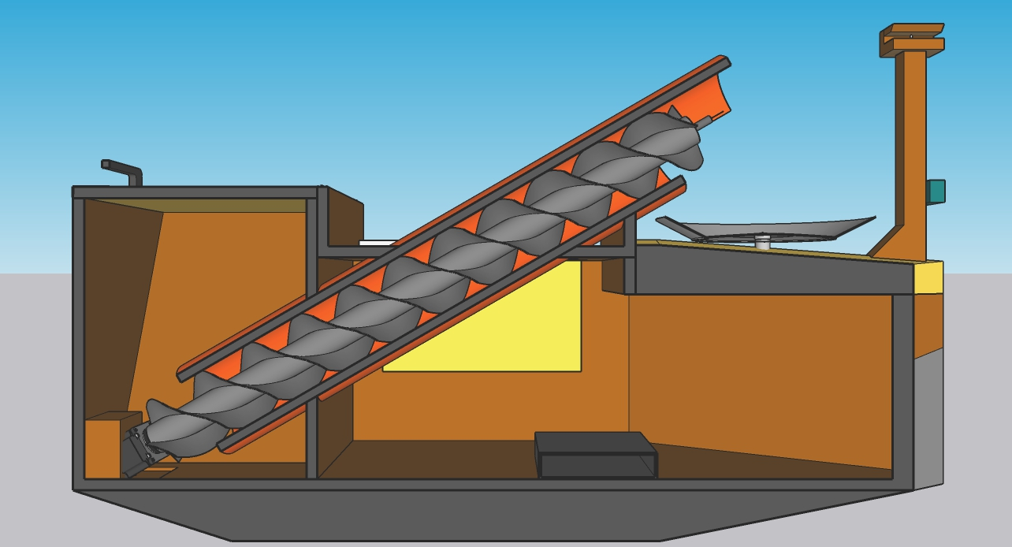
Traverse Motor
Front Pole
PVC Pipe
Feed Cover
Feed Spinner
Auger
Distance Sensor
Side Door
Electronic Box
Stepper Motor

